Slide 1
Coder Dojo- Scratch Beyond the Basics
Week 6

Slide 2
Tonight
Just a bit of instruction
A quick look at alternatives to Scratch
A quick look at web development
Your last chance to show cool stuff

Slide 3
Tonight’s challenge: some easy computer science
I have been staying away from “computer science”
Algorithms are a step-by-step procedure for calculations or achieving a goal.
Some times they are simple extensions of basic ideas.
“Repeat until ( )” is a basic idea.
Move an object across the bottom of the stage
“Nested loops” is a very simple algorithm
It means you have a repeat block INSIDE another repeat block

Slide 4
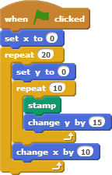
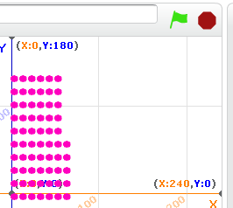
Nested Blocks
This is a nested block
This is how it’s drawn
Draws upwards,
And then moves right to draw the next column

Slide 5
My cool scratch page that uses nested blocks.
Point Towards Me

Slide 6
Oh Noes! My blocks are all over the place. Solve my puzzle!
I’ve created a puzzle challenge
Use cloning to draw many copies of a sprite using nested blocks
If the sprite is a clone, have it point toward the mouse pointer.
Start with scratch.mit.edu/projects/19402003

Slide 7
Some “easy” advanced math. Distance.
Do you know “squared”? It’s just the same number multiplied by itself. For example 5 squared is 25.
The square root of a number is what it would take to get that number if you multiplied it twice. The square root of 25 is 5.
Pythagorean theorem: The distance between two points of a “right” triangle’s long edge is the square root of the sum of its sides, squared.
The computer x-y coordinate system gives right triangles at any grid intersection

Slide 8
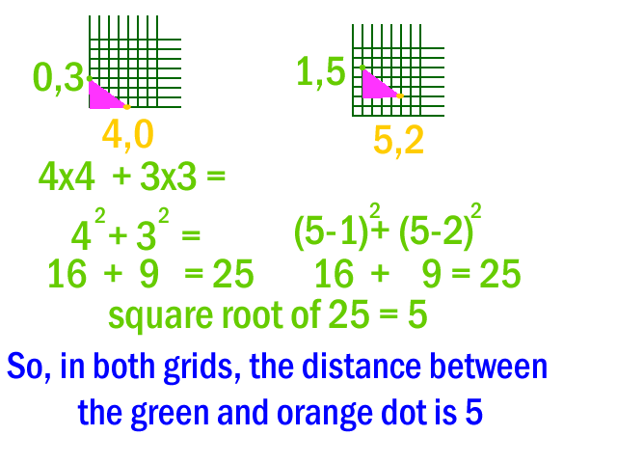
I

Slide 9
What can we do with ‘distance’? What else?
You can change appearance based on distance.
If the effect makes things invisible at “0”, a zero distance would be bad.
If you subtract from 100, you invert the effect
Distance can easily be more than 100, so you may need to dampen the effect by dividing by, oh, say, 5
Come up with some other ideas and try them out!
(Ghost, other color effects, change the sprite)
Rather than pointing toward the mouse, add another sprite that moves about (Falls down? Bounces?), and point towards it.

Slide 10
Scratch: More Resources
kata.coderdojo.com/wiki/ScratchTastic
Sort of unorganized
Be aware that most activities on the kata are written in Scratch 1.4.
In particular, the 'mesh' feature is cool but it doesn’t run in Scratch 2.0 (the web version we’ve been using)
LearnScratch.org (particularly "Book 3")
Also written in Scratch 1.4
Not always the best example. (Tonight’s activity was based on Book 3, Unit 4, Lesson 18. Don’t do it that way.)
scratch.mit.edu
http://scratch.mit.edu/help/ for guides and tutorials
http://scratch.mit.edu/discuss/ for message boards
http://wiki.scratch.mit.edu/wiki

Slide 11
Alternatives
Just Announced: ScratchJr for the ipad.
www.kickstarter.com/projects/2023634798/scratchjr-coding-for-young-kids
Snap.berkeley.edu
Designed to teach Computer Science, not just beginning programming
Runs on Tablets
AppInventor
You can write programs that run on Android Tablets (or emulated on PCs)
It’s a bit more challenging than Scratch

Slide 12
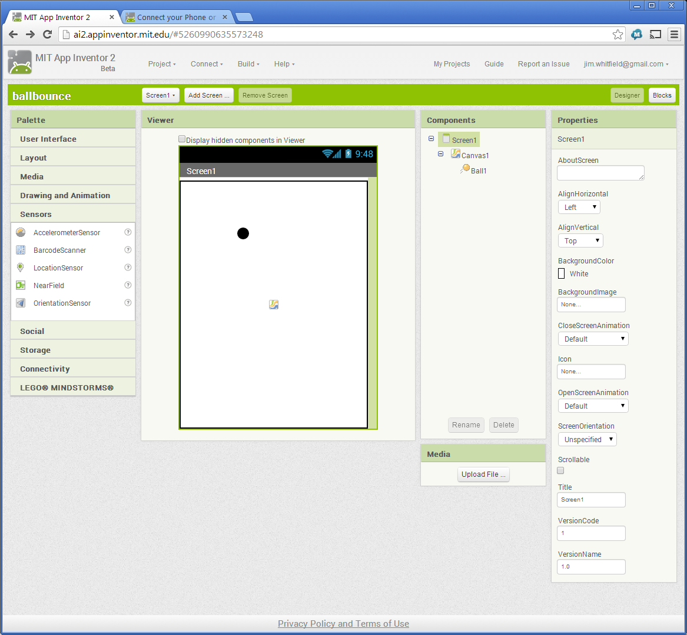
App Inventor screen shot #1

Slide 13
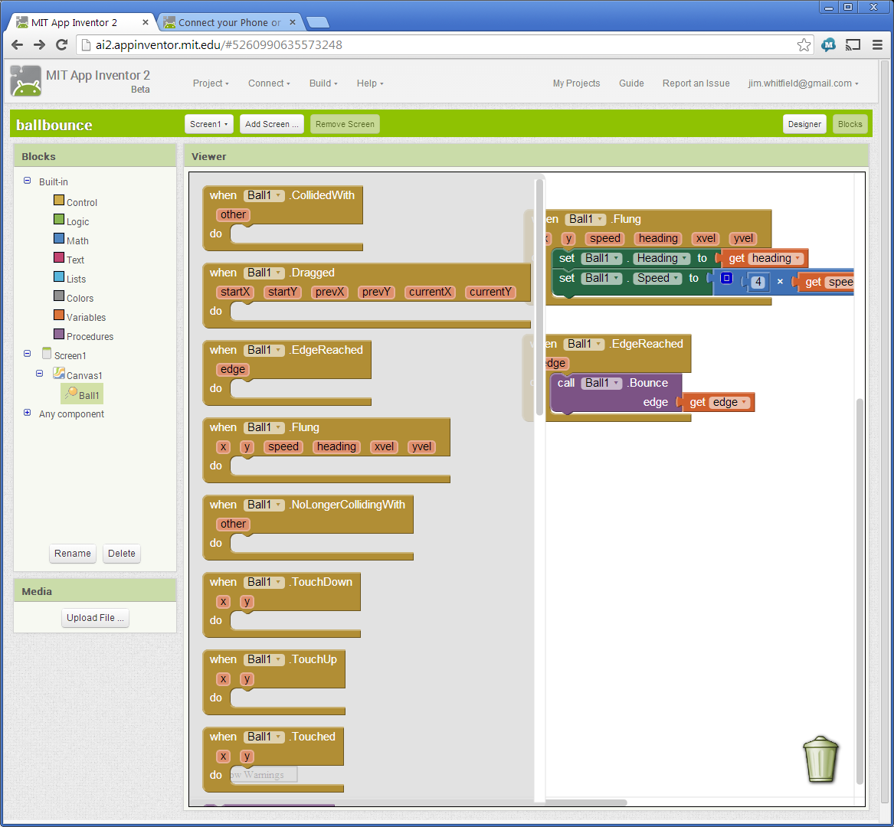
App Inventor Screenshot #2

Slide 14
A Plug for Web Development
CoderDojo frequently offers a web development track, and if you want to take a break from Scratch, it’s a great alternative. Also, Scratch isn’t yet part of the Spring offering.
I ran the Web session last December
http://codepen.io/jimwhitfield/details/Imbkx/
HTML - text and structure
CSS - appearance
Javascript – code. 'blocks' in Scratch, typing on web

Slide 15
In Conclusion,
I enjoyed showing you some fun Scratch projects and ideas.
I hope you enjoyed it.
I’m looking for ways to help you keep your momentum.
On Scratch.mit.edu, I'm JamWave. I'll reply to comments you leave on my profile http://scratch.mit.edu/users/jamwave/
If you add a project to CoderDojoSV sharing, I'll take a look at it. http://scratch.mit.edu/studios/353977/
Maybe "Office hours" via Google Helpout. (I'll aim for next week Tuesday at 7pm). If I do, look for a comment on my Scratch profile. It's an interesting idea, but we don't know if it will work out.

